Slide 1
Why use Bon Secours
Benefits of our Occupational Health program with Bon Secours:
Quick Access to Care – Convenient treatment for non-critical injuries or preventive care
Shorter Wait Times – Faster service compared to the ER
Employer Communication – Easy coordination for work-related health needs
Integrated Health System – High-quality care from a nationally recognized network
Workplace Safety & Prevention – Proactive health programs to reduce injuries
Faster Return to Work – Efficient recovery plans to minimize downtime

Slide 2
Why use Bon Secours?
Benefits of our Occupational Health program with Bon Secours:
Fast, Convenient Care – Get quick treatment for minor injuries or check-ups.
Get Back to Work Sooner – Plans that help you heal and return to work quickly.
Shorter Wait Times – Usually faster than going to the ER.
Easy Communication – We work closely with your employer to support your recovery.
Trusted Providers – Care from well-known and respected hospitals and specialized care providers.

Slide 3
Complete Network of Care
Understanding Levels of Care: Where to Go & When
Occupational Health Clinics: Work-related injuries, drug screens, physicals, vaccinations, care tailored for employees
Emergency Room (ER): Life-threatening injuries or symptoms (chest pain, stroke, severe bleeding, trauma)
Urgent Care: After-hours care for non-life-threatening issues (sprains, minor cuts, fever, ear infections)
Primary Care: Routine checkups, chronic condition management, vaccinations, and ongoing health concerns
Specialists: Advanced care for specific conditions (orthopedics, cardiology, dermatology, etc.)

Slide 4
What is Occupational Health?
Bon Secours Occupational Health is here to keep you healthy, on and off the job.
Occupational Health means:
Helping you stay safe and well at work
Treating work-related injuries or illnesses
Offering services like physicals, vaccines, drug screenings, and more
Supporting your recovery and return to work
Why it matters:
Quick access to care when you need it
Providers who understand your job and work environment
A healthier, safer workplace for everyone
Notes:
About mercy health slide: differences b/t, three prong approach

Slide 5
Heat Safety Tips
Stay safe when the temps rise
Drink water—even if you’re not thirsty
Take breaks in the shade or indoors
Wear light, breathable clothing
Watch for signs of heat exhaustion (dizziness, heavy sweating, nausea)
Feeling off? Visit an occupational health clinic or urgent care location for fast, expert care.
Notes:
About mercy health slide: differences b/t, three prong approach

Slide 6
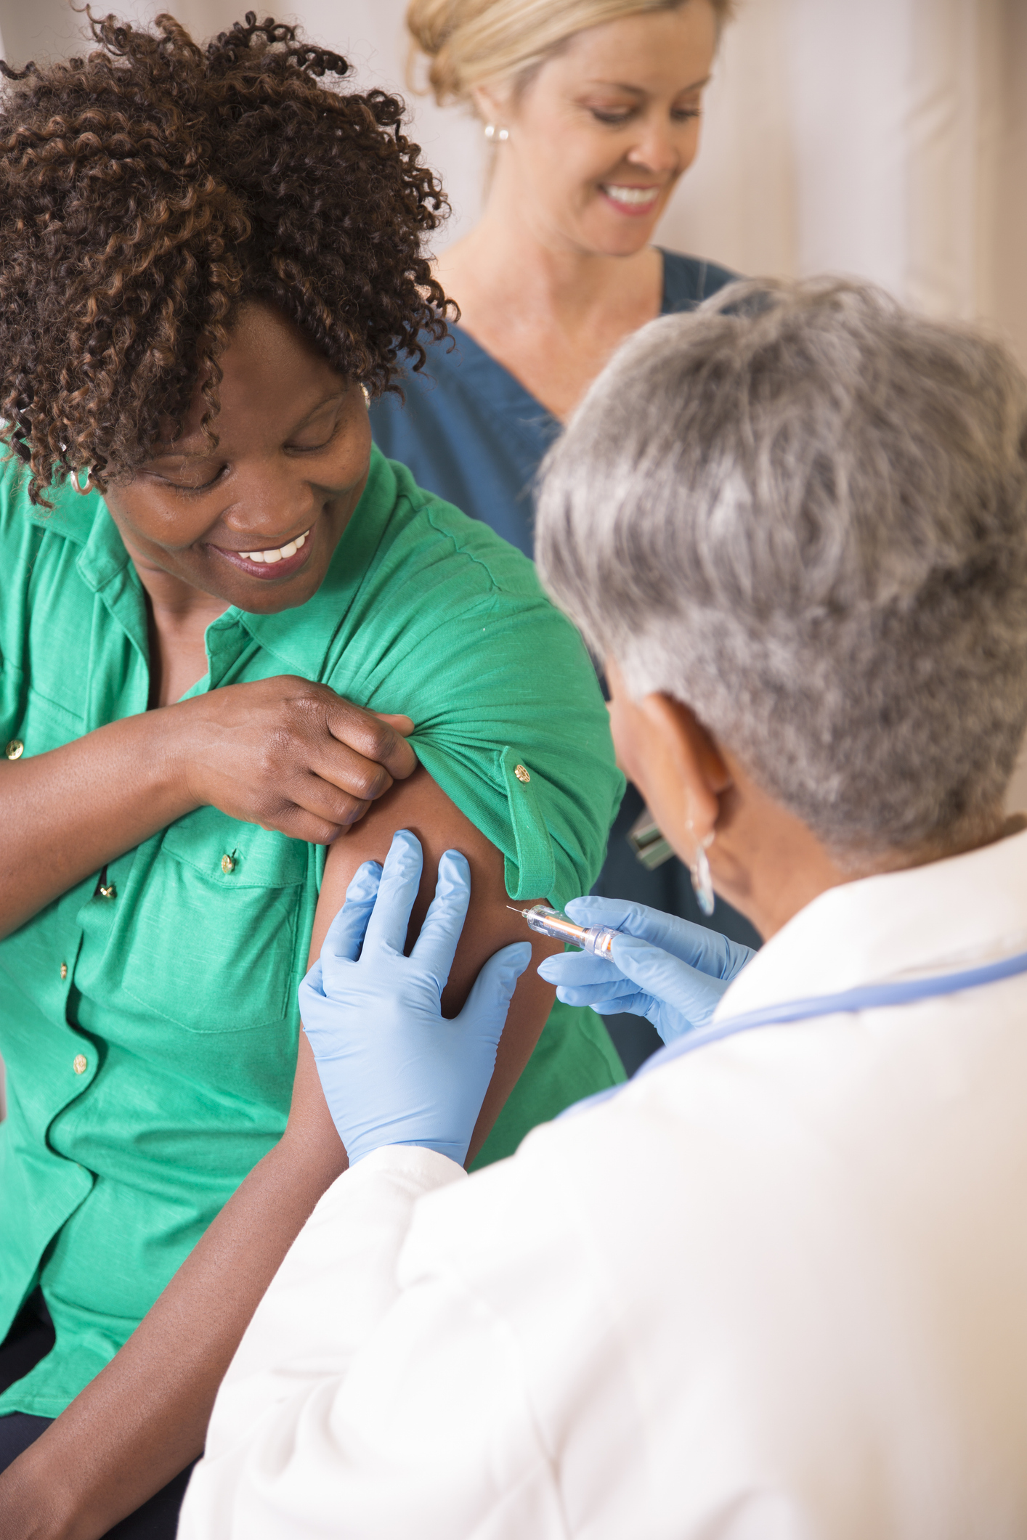
Flu & Cold Season
Stay ahead of seasonal sickness
Get your flu shot
Wash hands often
Cover coughs and sneezes
Stay home if you’re sick
Need a flu shot or feeling under the weather? We’re here to help, no appointment needed. Visit a Bon Secours Occupational Health Clinic today.
Notes:
About mercy health slide: differences b/t, three prong approach

